Slide 1


Data Structures
Week11_Lecture2
Tree Data Structures
Subhan Ullah, PhD
subhan.ullah@nu.edu.pk
BS(Cybersecurity) Fall-2023

Slide 2
Data Structures
13. AVL Trees

Slide 3
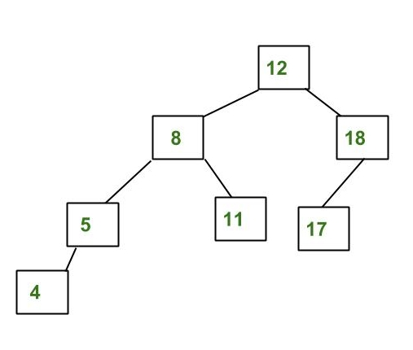
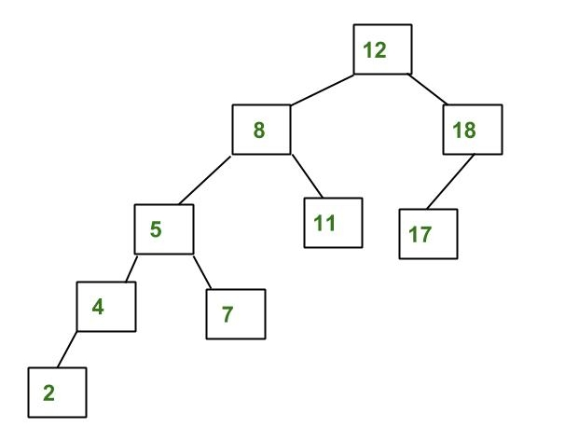
AVL Trees
AVL tree is a self-balancing Binary Search Tree (BST)
where the difference between heights of left and right subtrees cannot be more than one for all nodes
Not AVL Tree:
AVL Tree:
https://www.geeksforgeeks.org/insertion-in-an-avl-tree/

Slide 4
Balanced and Unbalanced BST
1
4
2
2
5
3
1
3
4
4
Is this “balanced”?
5
2
6
6
1
3
5
7
7

Slide 5
Balanced Tree
Want a (almost) complete tree after every operation
Tree is complete except possibly in the lower levels towards right
Maintenance of such a tree is expensive
For example, insert 2 in the tree on the left and then rebuild as a complete tree
6
5
Insert 2 &
complete tree
4
9
2
8
1
5
8
1
4
6
9

Slide 6
AVL Trees – Good but not Perfect Balance
Named after Adelson-Velskii and Landis
Balance is defined by comparing the height of the two sub-trees
Recall:
An empty tree has height –1
A tree with a single node has height 0

Slide 7
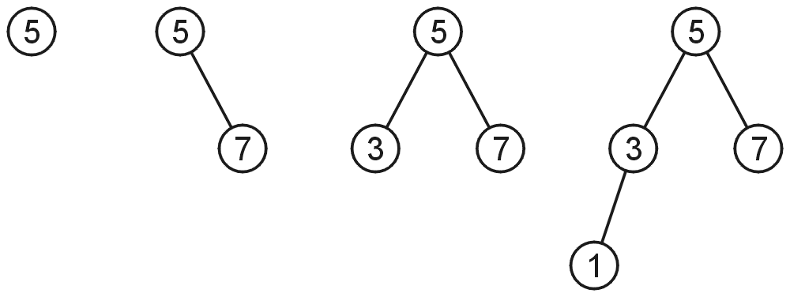
AVL Trees
A binary search tree is said to be AVL balanced if:
The difference in the heights between the left and right sub-trees is at most 1, and
Both sub-trees are themselves AVL trees
AVL trees with 1, 2, 3 and 4 nodes

Slide 8
AVL Trees – Example
5
7
2
8
2
8
1
4
7
1
4
3
3
5
An AVL Tree
Not an AVL Tree

Slide 9
AVL Trees – Balance Factor
An AVL tree has balance factor calculated at every node
Height of the left subtree minus the height of the right subtree
For an AVL tree, the balances of the nodes are always -1, 0 or 1
Height of node = h
Balance Factor (BF) = h_{left} - h_{right}
Empty height = -1
Tree A (AVL)
Tree B (AVL)
6
height=2 BF=1-0=1
6
1
4
9
0
4
9
0
0
1
5
-1
-1
1
5
8
-1
-1
-1
-1
-1
-1
-1
-1
-1
-1
-1

Slide 10
AVL Trees – Example
Tree A (AVL)
Tree B (not AVL)
3
balance factor
1-(-1) = 2
6
6
2
4
9
4
9
1
-1
1
5
7
1
5
8
0
7
Height of node = h
Balance factor = h_{left}-h_{right}
Empty height = -1

Slide 11
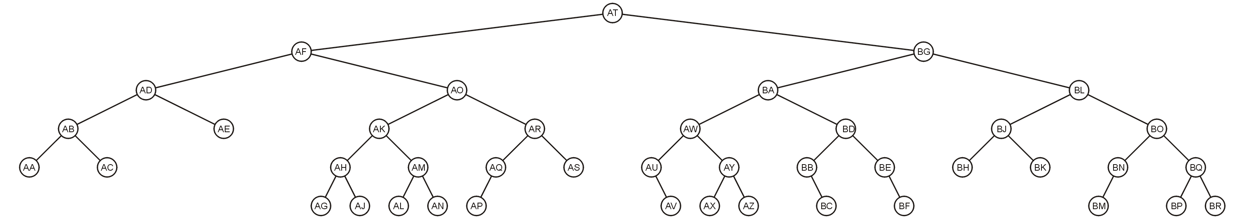
AVL Trees – Example
Here is a larger AVL tree (42 nodes)

Slide 12
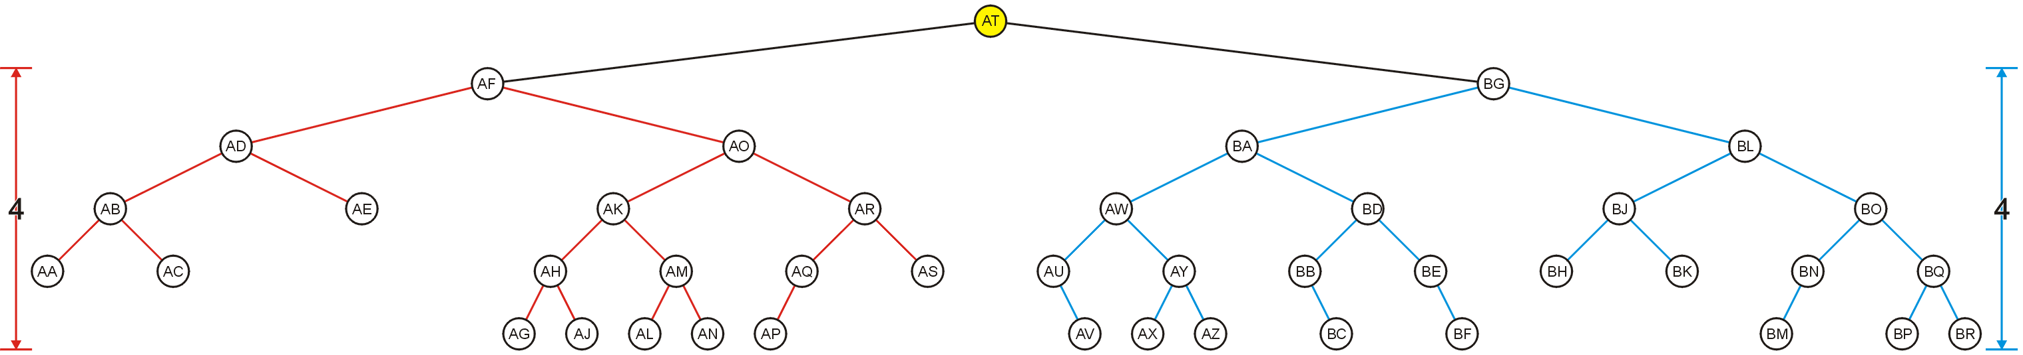
AVL Trees – Example
The root node is AVL-balanced
Both sub-trees are of height 4 (i.e., at root BF = 0)

Slide 13
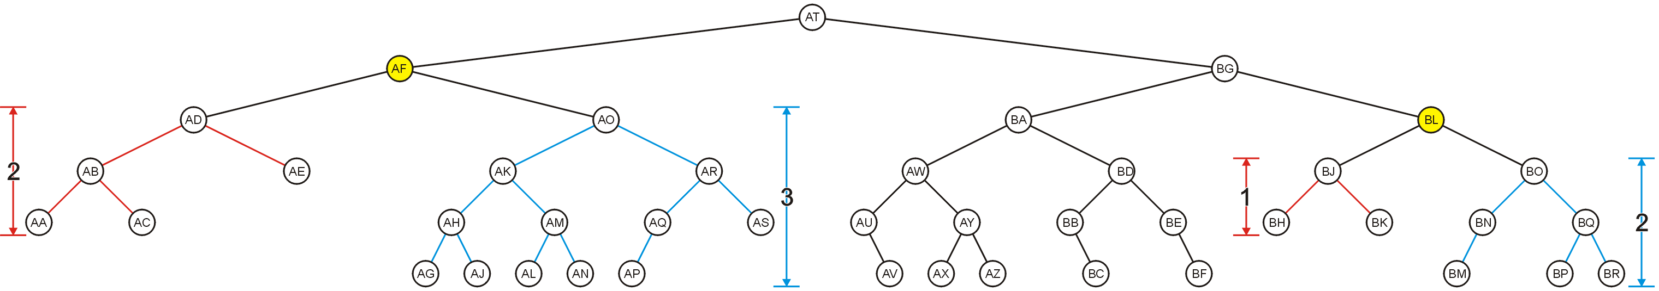
AVL Trees – Example
All other nodes (e.g., AF and BL) are AVL balanced
The sub-trees differ in height by at most one

Slide 14
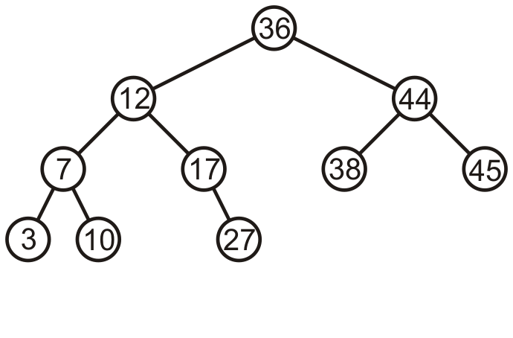
AVL Trees – Example
Consider this AVL tree

Slide 15
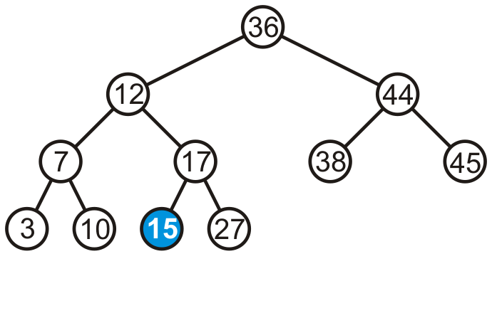
AVL Trees – Example
Consider inserting 15 into this tree
In this case, the heights of none of the trees change
Tree remains balanced

Slide 16
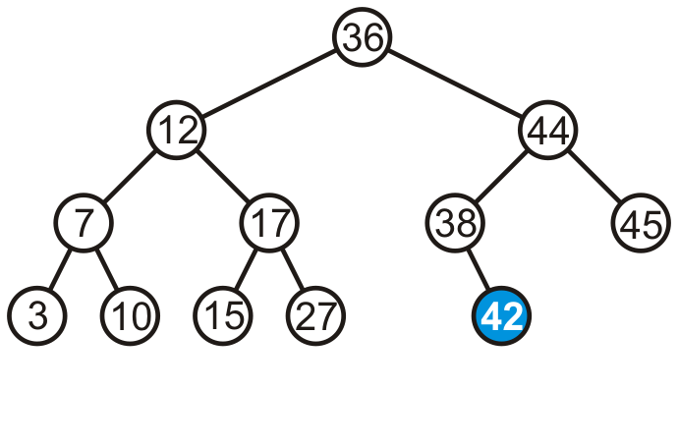
AVL Trees – Example
Consider inserting 42 into this tree

Slide 17
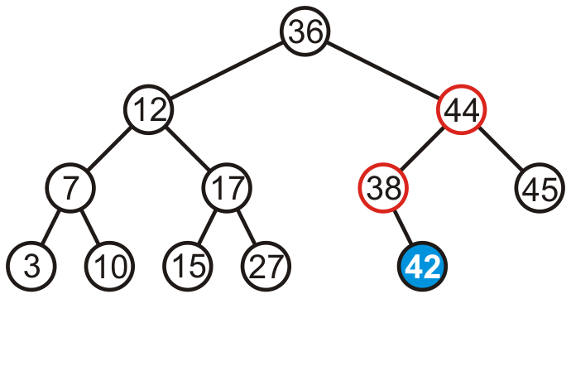
AVL Trees – Example
Consider inserting 42 into this tree
Height of two sub-trees rooted at 44 and 38 have increased by one
The tree is still balanced

Slide 18
AVL Trees
To maintain the height balanced property of the AVL tree, it is necessary to
Perform a transformation on the tree, such that
In-order traversal of the transformed tree is the same as for the original tree (i.e., the new tree remains a binary search tree)

Slide 19
Transformation (Rotation) of AVL Trees
Insert operations may cause balance factor to become 2 or –2 for some node
Only nodes on the path from insertion point to root node have possibly change in height
Follow the path up to the root, find the first node (i.e., deepest) whose new balance violates the AVL condition
Call this node “a”
If a new balance factor (the difference h_{left}-h_{right}) is 2 or –2
Adjust tree by rotation around the node “a”

Slide 20
Balancing AVL Trees – Example
If a tree is AVL balanced, for an insertion to cause an imbalance:
The heights of the sub-trees must differ by 1
The insertion must increase the height of the deeper sub-tree by 1

Slide 21
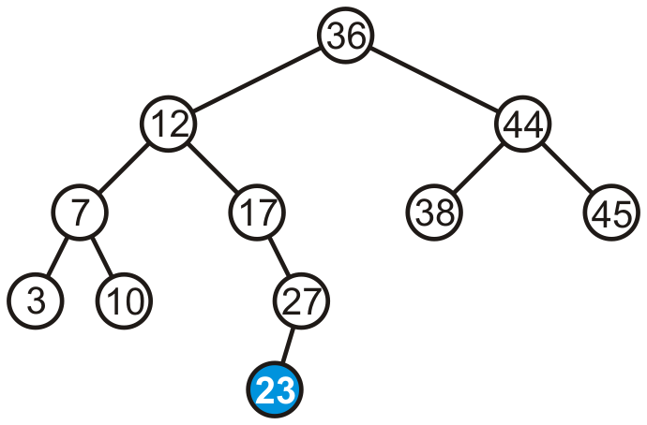
Balancing AVL Trees – Example
Suppose we insert 23 into our initial tree

Slide 22
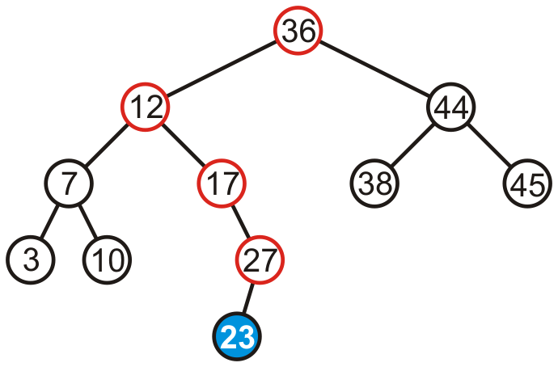
Balancing AVL Trees – Example
The heights of each of the sub-trees from the insertion point to the root are increased by one

Slide 23
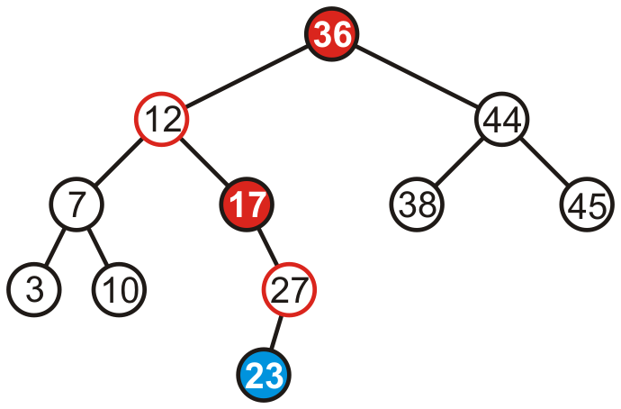
Balancing AVL Trees – Example
Only two of the nodes are unbalanced, i.e., 17 and 36
Balance factor of 17 is -2
Balance factor of 36 is 2

Slide 24
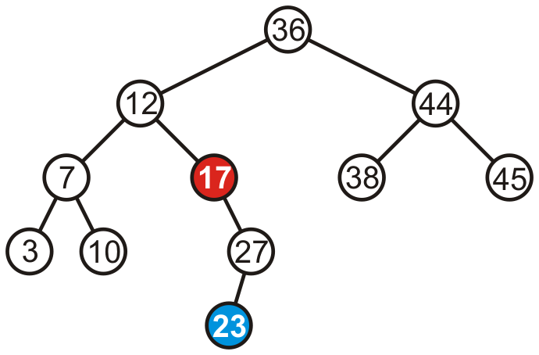
Balancing AVL Trees – Example
We only have to fix the imbalance at the lowest node

Slide 25
Fixing Imbalance By Rotation
Let the node that needs rebalancing be “a”
Imbalance during insertion may be handled using four cases
Outside cases (Single Rotation)
Right rotation (case RR)
Left rotation (case LL)
Inside cases (Double Rotation)
Right-left rotation (case RL)
Left-right rotation (case LR)

Slide 26
Single Rotation in an AVL Tree
2
2
6
6
1
2
1
1
4
9
4
8
0
0
1
0
0
0
0
1
5
8
1
5
7
9
0
7

Slide 27
Right Rotation (RR) in an AVL Tree
Node “b” becomes the new root
Node “b” takes ownership of node “a”, as it's right child
Node “a” takes ownership of node “b” right child (NULL if no child)
As left child of node “a”
a
b
b
c
a
c

Slide 28
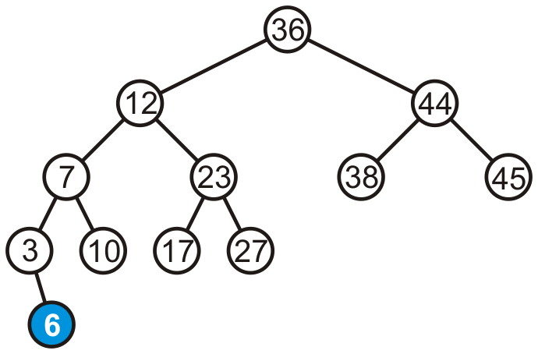
Right Rotation (RR) – Example
Consider adding 6

Slide 29
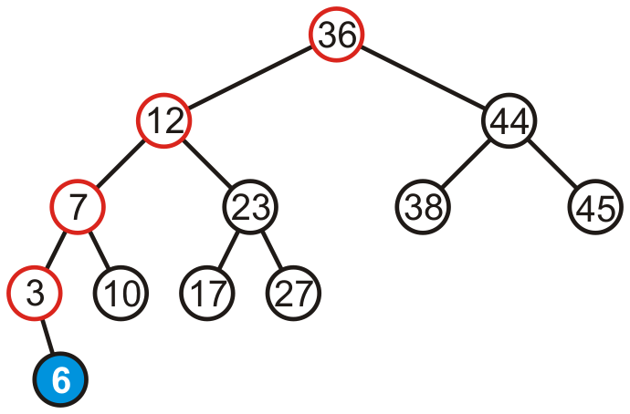
Right Rotation (RR) – Example
Height of each of the trees in the path back to the root are increased by one

Slide 30
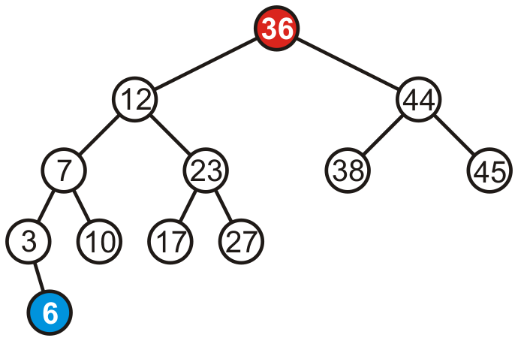
Right Rotation (RR) – Example
Height of each of the trees in the path back to the root are increased by one
Only root node (i.e., 36) violates the balancing factor

Slide 31
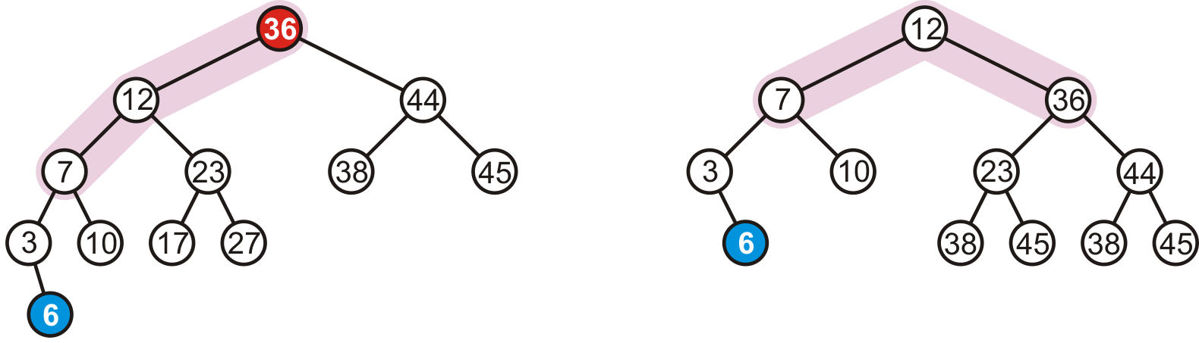
Right Rotation (RR) – Example
To fix the imbalance, we perform right rotation of root (i.e., 36)
17
27

Slide 32
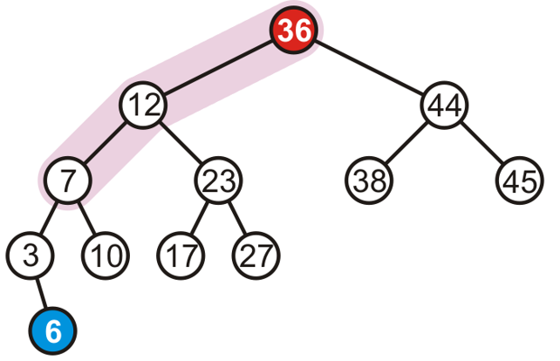
When to Perform Right Rotation (RR)?
Let the node that needs rebalancing be “a”
Case LL
Insertion into left subtree of left child of node “a”
Left tree is heavy (i.e., h_{left} > h_{right} )

Slide 33
When to Perform Right Rotation (RR)
Let the node that needs rebalancing be a
Case RR
Insertion into left subtree of left child of node a (RR)
Left tree is heavy (i.e., h_{left} > h_{right} )

Slide 34
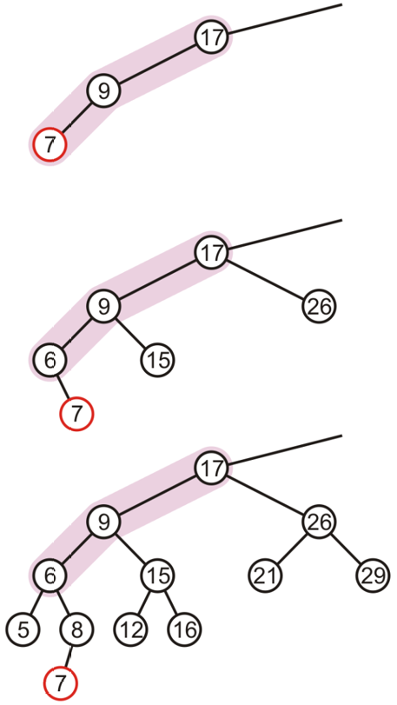
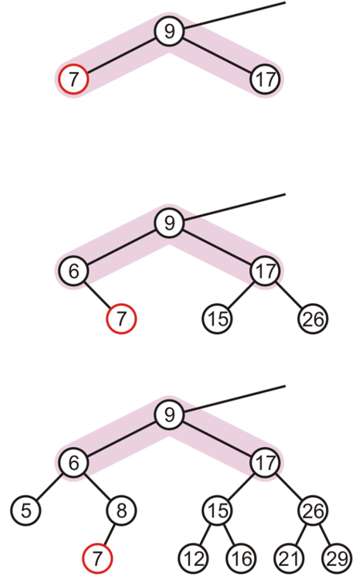
Right Rotation (RR) – Examples

Slide 35
Left Rotation (LL) in an AVL Tree
Node “b” becomes the new root
Node “b” takes ownership of node “a” as its left child
Node “a” takes ownership of node “b” left child (NULL if no child)
As right child of node “a”
a
b
b
a
c
c

Slide 36
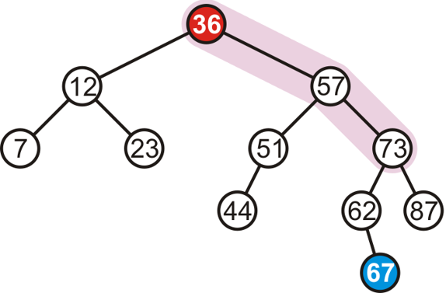
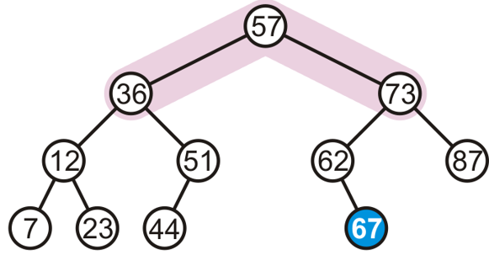
Left Rotation (LR) – Example
Consider adding 67
To fix the imbalance, we perform left rotation of root (i.e., 36)

Slide 37
When to Perform Left Rotation (LR)
Let the node that needs rebalancing be “a”
Case RR
Insertion into right subtree of right child of node a
Right tree is heavy (i.e., h_{left} < h_{right} )

Slide 38
When to Perform Left Rotation (LL)
Let the node that needs rebalancing be a
Case LL
Insertion into right subtree of right child of node a (RR)
Right tree is heavy (i.e., h_{left} < h_{right} )

Slide 39
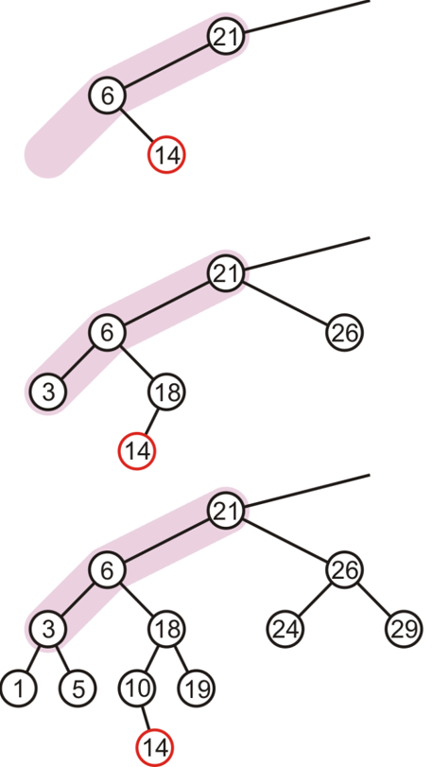
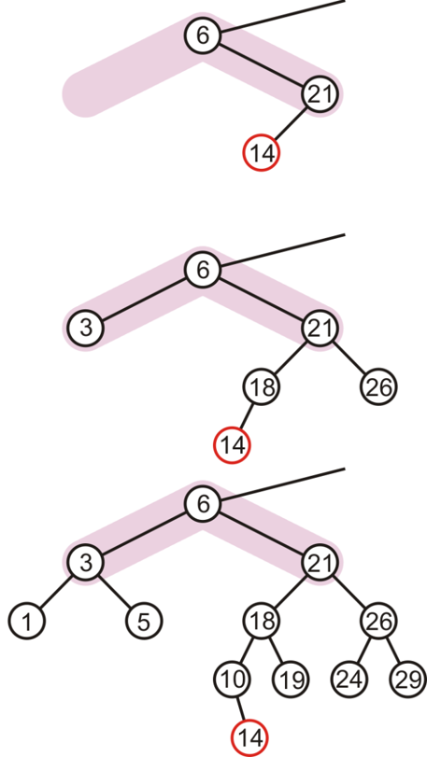
Single Rotation May Be Insufficient
The imbalance is just shifted to the other side

Slide 40
Right-Left Rotation (RL) or "Double Right"
c
c
b
Right
a
b
Left
a
c
b
a
Perform a left rotation on the left subtree
Node “b” becomes the new root
Node “b” takes ownership of node “c” as its right child
Node “c” takes ownership of node “b” right child
As its left child

Slide 41
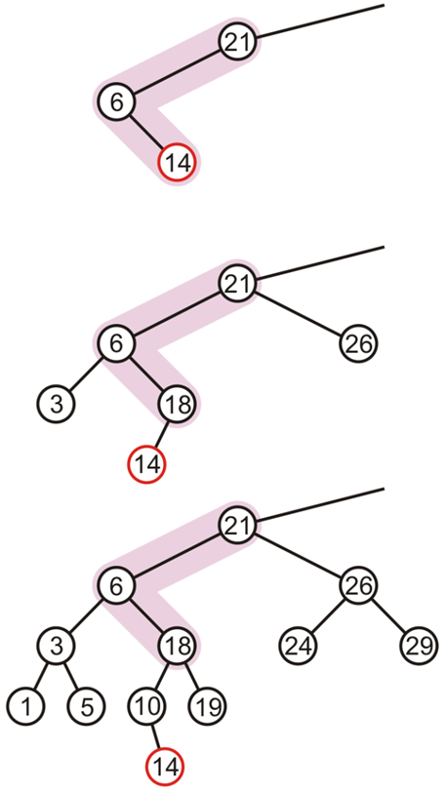
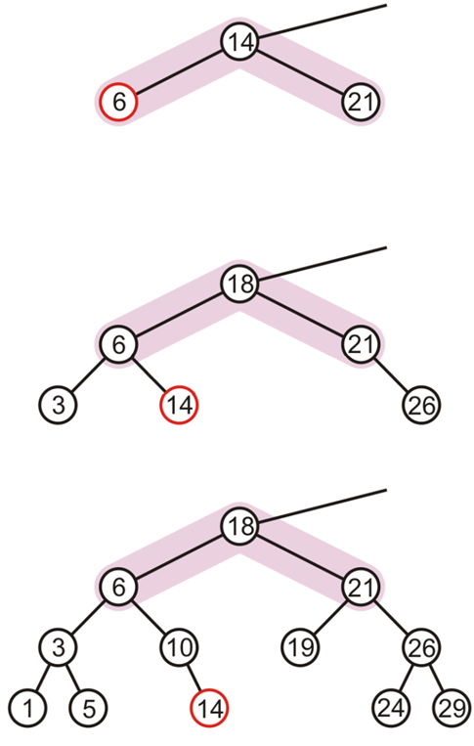
Right-Left Rotation (RL) or "Double Right" – Example

Slide 42
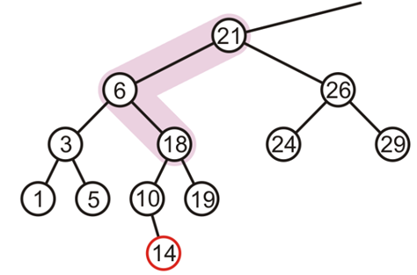
When to Perform Right-Left Rotation (RL)
Let the node that needs rebalancing be “a”
Case RL
Insertion into right subtree of left child of node “a”

Slide 43
When to Perform Right-Left Rotation (RL)
Let the node that needs rebalancing be a
Case RL
Insertion into right subtree of left child of node a (RL)
Left heavy
Right heavy

Slide 44
Left-Right Rotation (LR) or "Double Left"
a
a
b
Left
c
b
a
c
Right
b
c
Perform a right rotation on the right subtree
Node “b” becomes the new root
Node “b” takes ownership of node “a” as its left child
Node “a” takes ownership of node “b” left child
As its right child

Slide 45
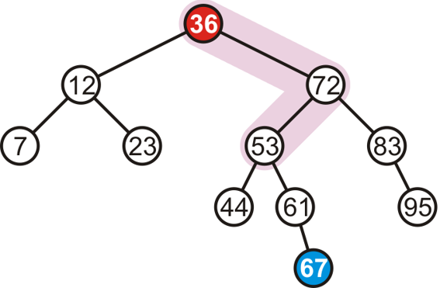
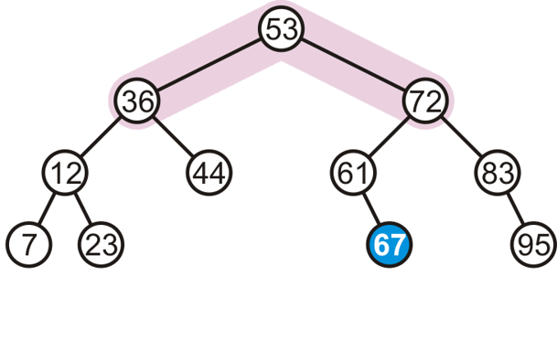
Left-Right Rotation (LR) or "Double Left" – Example
Consider adding 67
To fix the imbalance, we perform left-right (LR) rotation of root

Slide 46
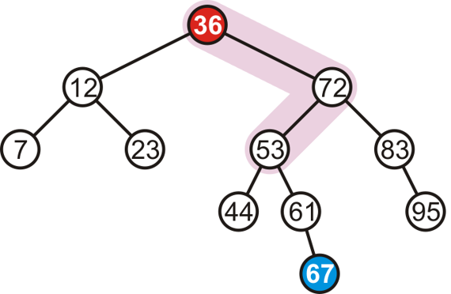
When to Perform Left-Right Rotation (LR)
Let the node that needs rebalancing be a
Case LR
Insertion into left subtree of right child of node a

Slide 47
When to Perform Left-Right Rotation (LR)
Let the node that needs rebalancing be a
Case LR
Insertion into left subtree of right child of node a (LR)
Right heavy
Left heavy

Slide 48
Summary: How And When To Rotate?
Let the node that needs rebalancing be “a”
Violation during insertion may occur in four cases
Outside cases (Single Rotation)
Insertion into left subtree of left child of node a (case RR)
Insertion into right subtree of right child of node a (case LL)
Case 1: RR
Case 2: LL

Slide 49
Summary: How And When To Rotate?
Let the node that needs rebalancing be “a”
Violation during insertion may occur in four cases
Inside cases (Double Rotation)
Insertion into right subtree of left child of a (case RL)
Insertion into left subtree of right child of a (case LR)
Case 3: RL
Case 4: LR

Slide 50
Summary: How And When To Rotate?
if tree is right heavy {
if tree's right subtree is left heavy {
Perform Left-Right rotation
}
else {
Perform Single Left rotation
}
}
…
…
else if tree is left heavy {
if tree's left subtree is right heavy {
Perform Right-Left rotation
}
else {
Perform Single Right rotation
}
}

Slide 51
AVL Tree visualizations
https://visualgo.net/en/bst
https://cmps-people.ok.ubc.ca/ylucet/DS/AVLtree.html

Slide 52
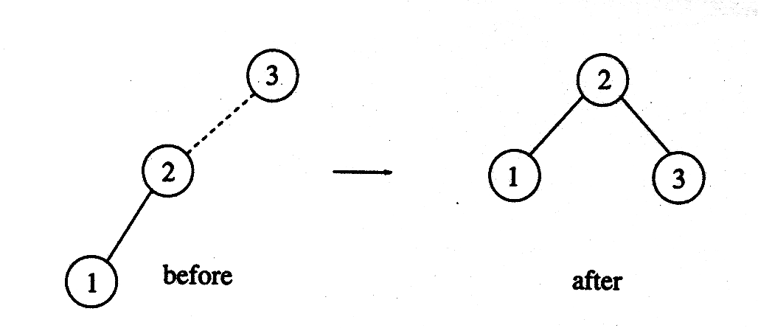
AVL Tree – Complete Example
Construct AVL Tree with the following input elements
3, 2, 1, 4, 5, 6, 7
Insert 3, 2, 1
Insert 4, 5

Slide 53
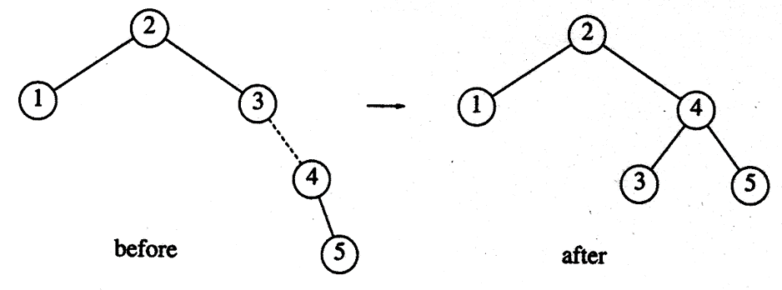
AVL Tree – Complete Example
Construct AVL Tree with the following input elements
3, 2, 1, 4, 5, 6, 7
Insert 4, 5
Insert 6

Slide 54
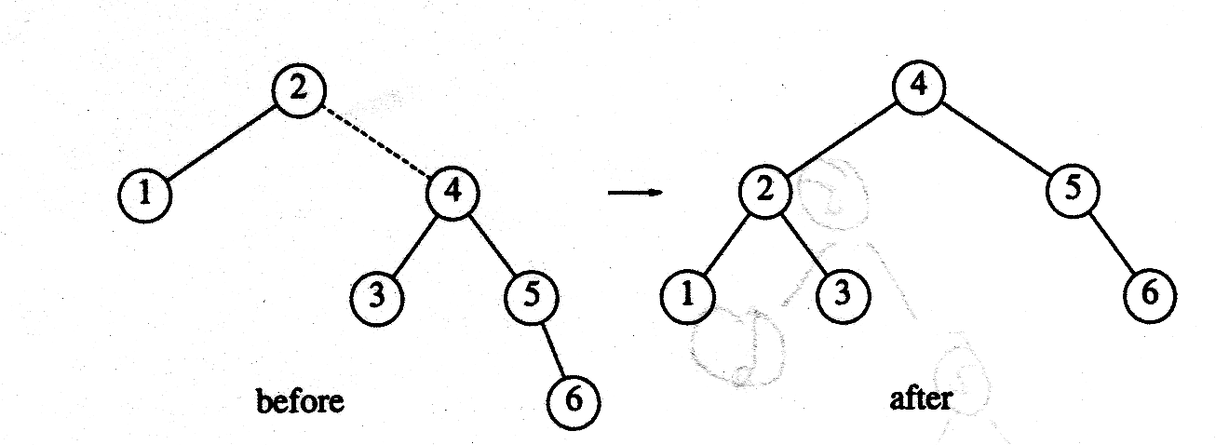
AVL Tree – Complete Example
Construct AVL Tree with the following input elements
3, 2, 1, 4, 5, 6, 7
Insert 6
Insert 7

Slide 55
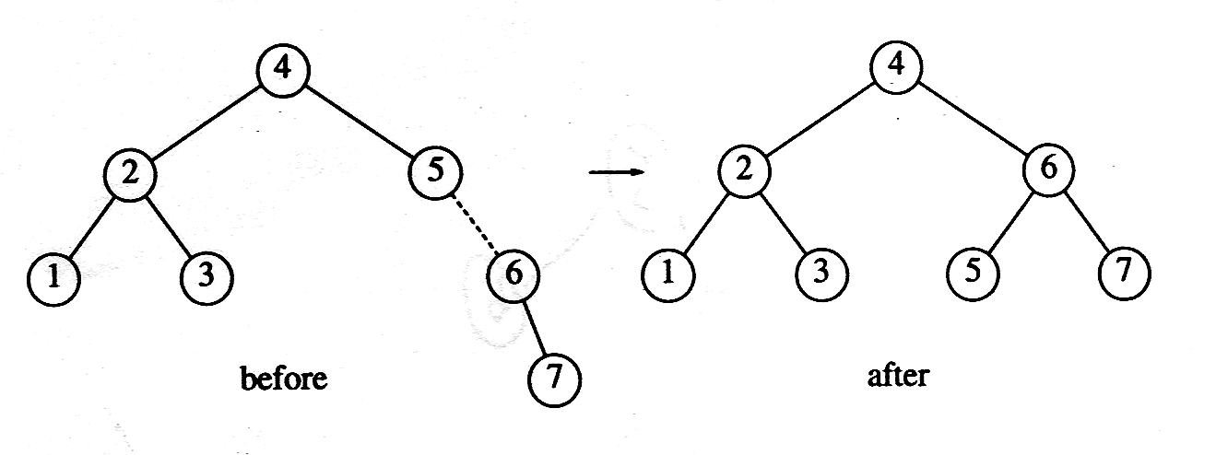
AVL Tree – Complete Example
Construct AVL Tree with the following input elements
3, 2, 1, 4, 5, 6, 7
Insert 7

Slide 56
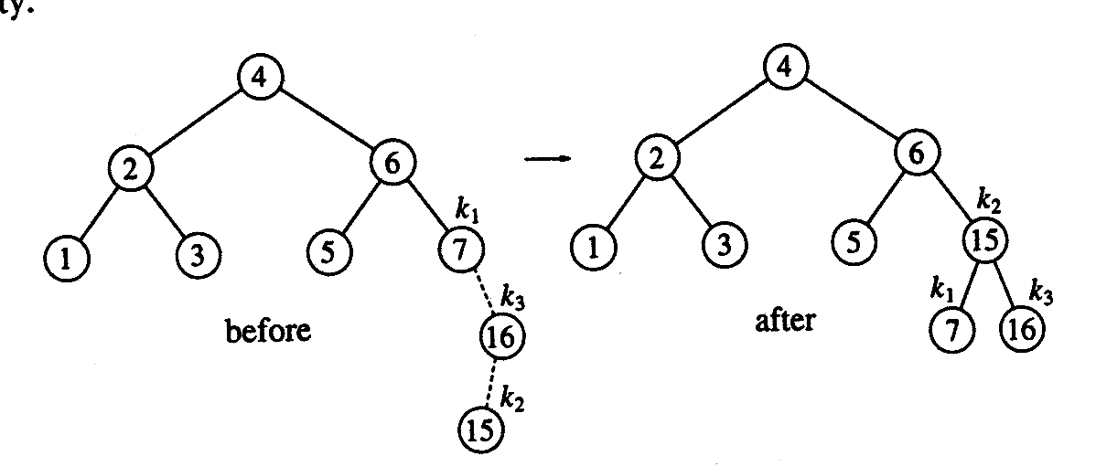
AVL Tree – Complete Example
Suppose the following elements have to be inserted further
16, 15, 14, 13, 12, 11, 10, 8
Insert 16, 15
Insert 14
Notes:
LR Rotation → First right then left

Slide 57
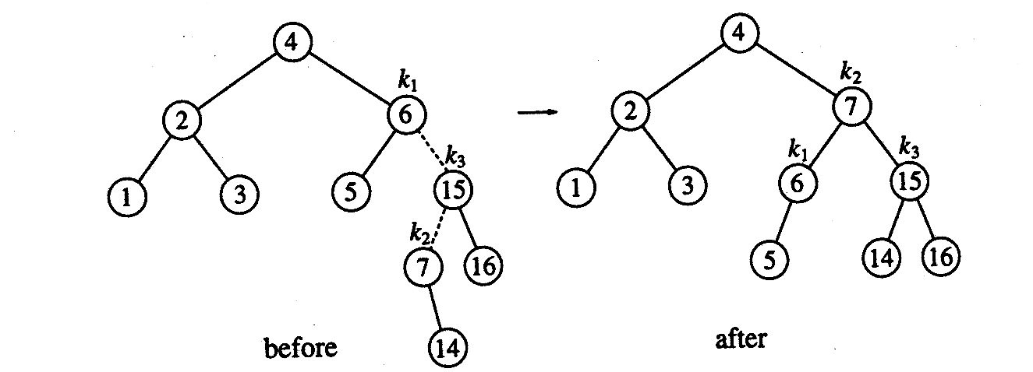
AVL Tree – Complete Example
Suppose the following elements have to be inserted further
16, 15, 14, 13, 12, 11, 10, 8
Insert 14
Insert 13
Notes:
LR Rotation → First right then left

Slide 58
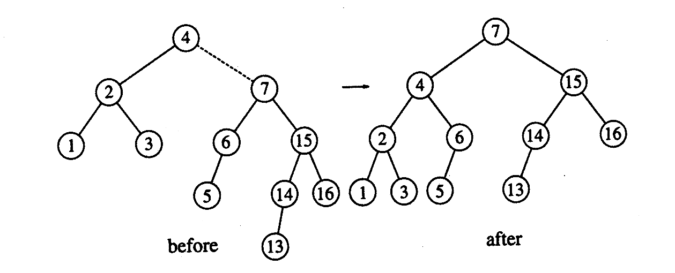
AVL Tree – Complete Example
Suppose the following elements have to be inserted further
16, 15, 14, 13, 12, 11, 10, 8
Insert 13
Insert 12
Notes:
LL case

Slide 59
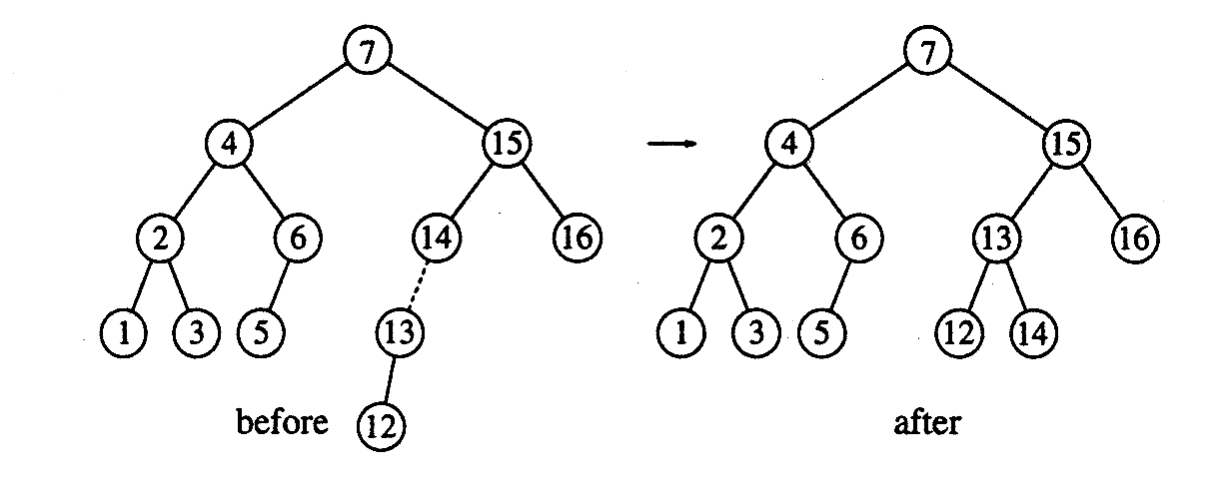
AVL Tree – Complete Example
Suppose the following elements have to be inserted further
16, 15, 14, 13, 12, 11, 10, 8
Insert 12
Insert 11, 10
Notes:
LL case

Slide 60
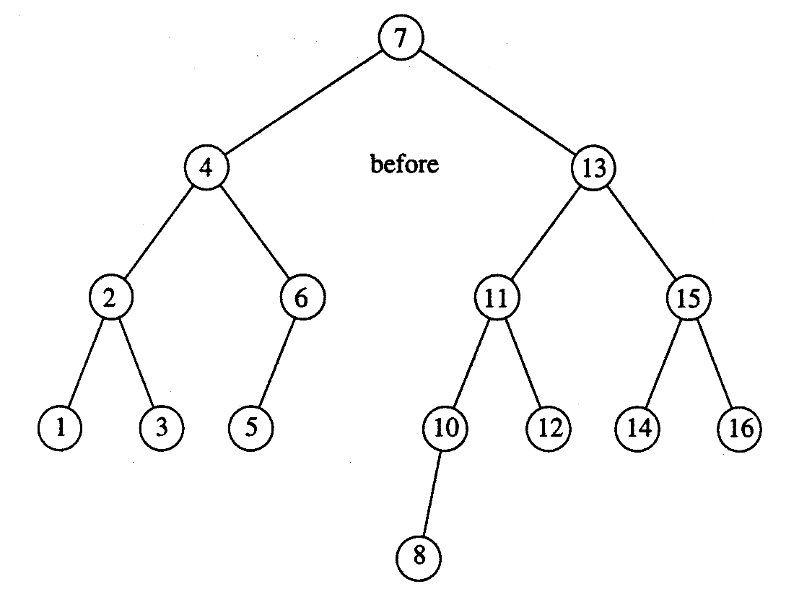
AVL Tree – Complete Example
Suppose the following elements have to be inserted further
16, 15, 14, 13, 12, 11, 10, 8
Insert 11, 10 then 8
Notes:
LL case

Slide 61


